Slide 1
DATA LINK LAYER ATTACKS AND SECURITY
Guided By :
Swapna V
Submitted By:
Vaishnavi V Rao
AM.EN.P2CSN19009

Slide 2
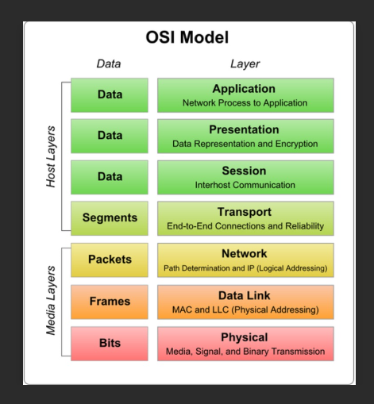
What is data link layer
The data link layer is the second layer of the seven-layer OSI model of computer networking.
This layer transfers data between adjacent network nodes in a wide area network(WAN) or between nodes on the same local area network(LAN).

Slide 3
Intrusion Detection and Prevention Systems
Identifying signatures and anomalies associated with attacks against the data link layer on wired networks.
Methods for signature-based detection and anomaly-based detection are not new. Intrusion detection systems such as SNORT are quite capable of detecting some of the known data link layer attacks and include a mechanism for integrating Intrusion Prevention System (IPS) solutions.
Then what’s the problem? Can a normal user like me and you afford this IPS system?

Slide 4
Taxonomy of Data Link Layer Attacks
adversary attempt for an attacker is to compromise confidentiality, authentication, or availability of information.
The attacks succeed for the most part because of the lack of fine-grain controls for the data link layer.
Yeung, Fung, and Wong (2008) enumerated several of the different tools used to implement layer 2 attacks. However, all of the tools rely on the lack of proper authentication during layer 2 communication.
For wired data link layer attacks, we examine CAM Table Exhaustion Attacks, ARP Spoofing, DHCP Exhaustion Attacks, and VLAN Hopping.

Slide 5
DATA LINK LAYER ATTACKS ON WIRED NETWORKS
1. CAM table exhaustion
How to conduct this attack
A CAM Table Exhaustion attack essentially turns a switch into a hub. To succeed, an attacker floods the CAM Table with new MAC-port mappings
When the CAM table fills up beyond the fixed memory, it no longer knows how to deliver based on MAC-port bindings, hence it begins broadcasting.
Once the switch begins broadcasting, any connected adversary can hear the traffic that flows through the switch
Tool used macof
The entire toolkit is available for download at http://www.monkey.org/~dugsong/dsniff/.
Protocol used:CAM

Slide 6
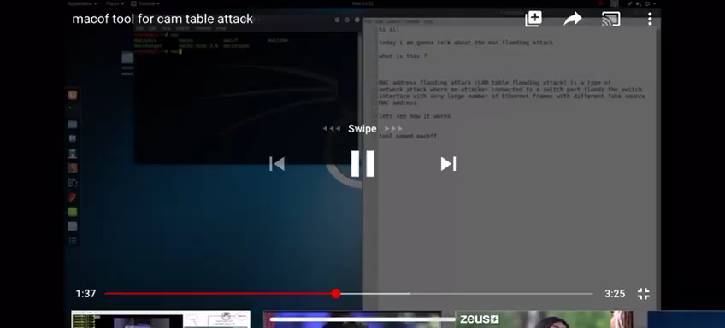
Macof Flooding a Switch With Random MAC Addresses

Slide 7
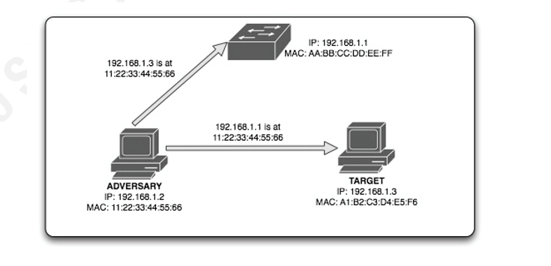
2.ARP SPOOFING
Protocol used:ARP
Depicting man in the middle attack

Slide 8
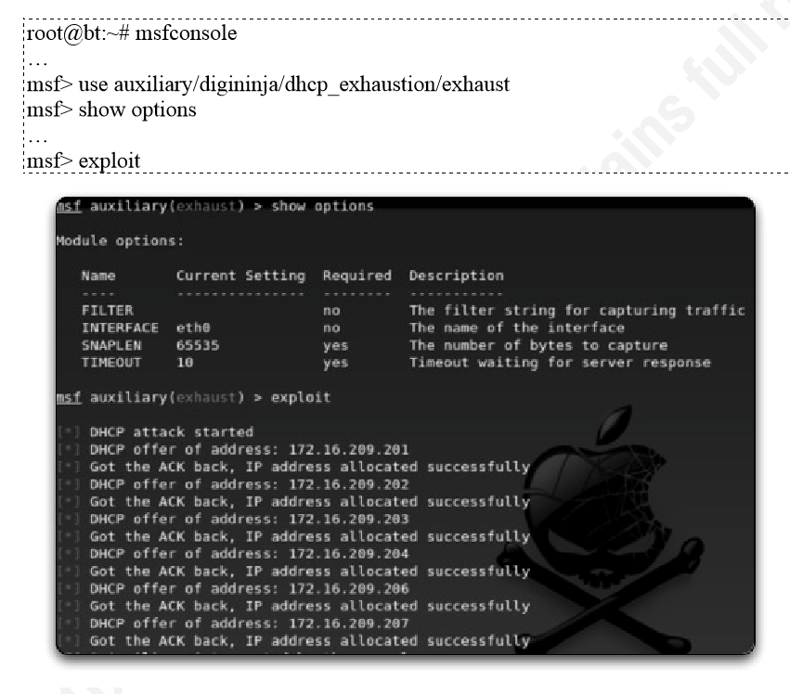
3.DHCP STARVATION ATTACK
Protocol used DHCP
DHCP Exhaustion Attack MetaSploit Module

Slide 9
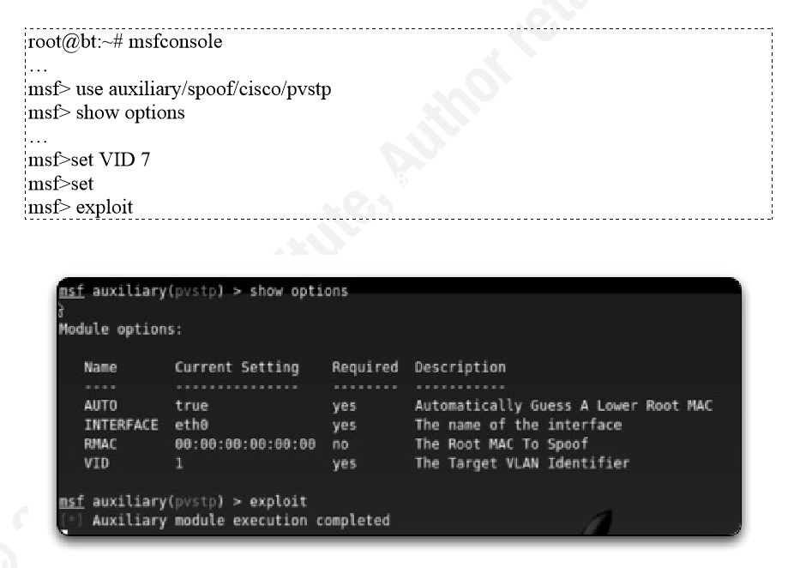
4.VLAN HOPPING ATTACKS
Protocol used VLAN
MetaSploit Vlan Hopping Attack Module

Slide 10
DETECTION
Different vendors provide unique security solutions for their layer 2 products. For example, Cisco provides several different proprietary configuration settings such as port security, secure MAC addressing, and BPDU guards to prevent attacks against the data link layer.
It also offers DAI, which verifies IP-to-MAC address bindings and discards invalid layer 2 packets. These proprietary mechanisms are effective and proven at stopping layer 2 attacks.
But what happens when you are not behind a proprietary device with layer 2 security? How can we prevent layer 2 attacks?

Slide 11
CAM TABLE EXHAUTION DETECTION
Packet sniff on interface
Set threshold 254 addresses in 4 sec
Add mac address to array
No
Check>threshold
yes
Cam table exhaustion detected

Slide 12
ARP SPOOFING DETECTION
monitor
no
Rebroadcast
yes
Check the ARP TABLE for any change
Display detection

Slide 13
DHCP EXHAUSTION DETECTION
Detect frame count Bootp with opcode 01
Set threshold
(no of requests per second)
If request exceed threshold count
yes
No
Detect dhcp exhaustion attack
DHCP Exhaustion Attack Detection Script

Slide 14
VLAN HOPPING ATTACK DETECTION
Two methods
1.Prevent switch spoofing
To make switch spoofing impossible, we can disable trunking on all ports that do not need to form truncks, and disable DTP on ports that do need to be trunks
2.Prevent double tagging
Double tagging attacks can be prevented by keeping the native VLAN of the trunk ports different from the user VLANs.

Slide 15
CONCLUSION
The idea of using scripts to detect attacks solves the problem of a user with degraded service at a hotel area network or a professor visiting a conference overseas that wants to determine if he is being arpspoofed. .
However, this not advocate using scripts as a long-term solution to intrusion detection needs or intrusion prevention solutions. Certainly, it does not scale to enterprise.

Slide 16
REFERENCES
[1] Hsieh, W., Lo C., Lee J., & Huang, L. (2004). The implementation of a proactive wireless intrusion detection system. Computer and Information Technology, 581586.
[2] Valli, Crag. (2004, November). Wireless SNORT – A WIDS in progress. Proceedings of the 2nd Australian Computer, Network and Information Forensics Conference, Perth, Western Australia
[3] Wright, J. (2003). Detecting wireless LAN MAC address spoofing. Retrieved June 29, 2010, from http://www.ecsl.cs.sunysb.edu/~fanglu/wlan_spoof_detection.htm
[4] Yeung, K., Fung, D., & Wong, K. (2008). Tools for attacking layer 2 network infrastructure. Proceedings of the International MultiConference of Engineers and Computer Scientists 2008, II.
[5] Malicious JavaScript Insertion through ARP Poisoning AttacksMay/June 2009, pp. 72-74, vol. 7DOI Bookmark: 10.1109/MSP.2009.72

